Slide 1
Drawproof
Construction money should move
only when the building does
Tilted Tower Townhomes
Foundation
$240K
Released
Framing
$360K
Released
Roofing
$180K
In review
Interiors
$300K
Locked
Handover
$120K
Locked

Slide 2

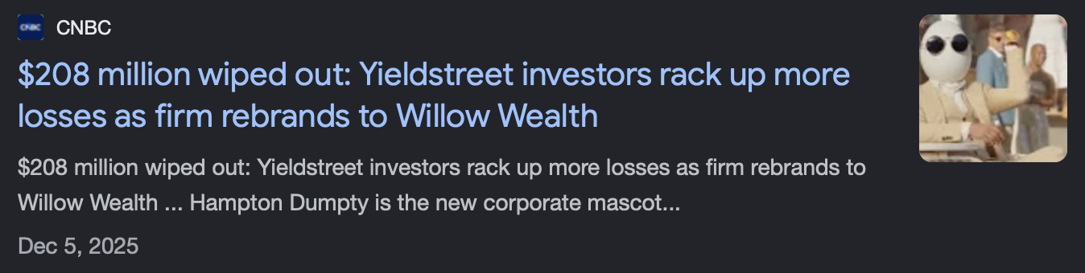
When project funds lose accountability
$62.8M
Stolen from 800+ investors
via CrowdStreet, a real estate
crowdfunding platform
Our focus: evidence → review → payment

Slide 3
Verification tied to payment
AI
Reviews evidence consistency
Inspector
Signs the site audit
XRP Ledger
Records proof and fixes escrow destinations
Our platform controls release timing

